Slide 1
Potential devices for discharge testing
Kai Jarosch
Plain City OH, Sept-21-2015
Background for Orange Ultrasonics

Slide 2
Reactor for testing discharge approaches
Pilot reactor (old style) – VPP-2
Three coolant layers
Two process layers
Each layer made up of 3 separate waveforms
Catalyst is was not given optimal post operative treatment
Represents a ‘difficult’ discharge case
Single waveform
Contains single waveform between two endplates
Catalyst treated to simulate impact of operation
Core size with header (ex tubing): 25.25”x8.06”x2.75
Core only: 24”x 7.756”x 2.25”
Weight (ex catalyst): ~120 lb
Core catalyst volume: 554 ml

Slide 3
Single waveform device
Overview
Open face
Open face

Slide 4
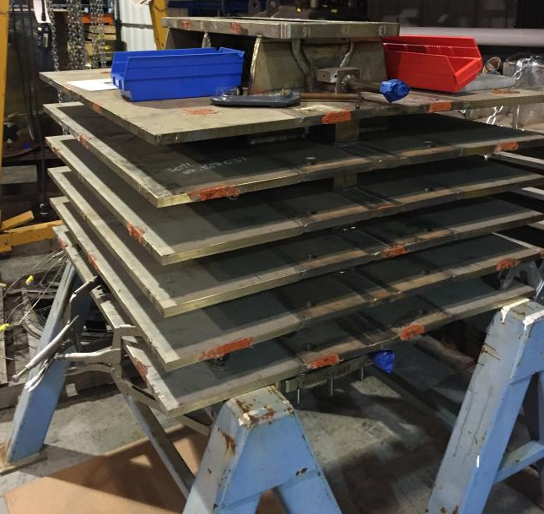
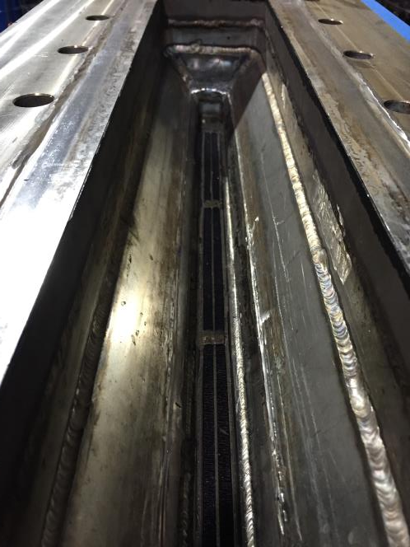
VPP-2 pilot reactor
Header
External view
Waveform pair

